Slide 1
How to install Python Anaconda

Slide 2
What is Python and why it is used?
Python is a computer programming language often used to build
websites and
software,
automate tasks, and
conduct data analysis.
Python is a general-purpose language, meaning it can be used to create a variety of different programs and isn't specialized for any specific problems.

Slide 3
What can you do with python?
Some things include:
Data analysis and machine learning
Web development
Automation or scripting
Software testing and prototyping
Everyday tasks

Slide 4
Why Python?
Python works on different platforms (Windows, Mac, Linux, Raspberry Pi, etc).
Python has a simple syntax similar to the English language.
Python has syntax that allows developers to write programs with fewer lines than some other programming languages.
Python runs on an interpreter system, meaning that code can be executed as soon as it is written. This means that prototyping can be very quick.
Python can be treated in a procedural way, an object-orientated way or a functional way.

Slide 5
Who uses Python today?‎
Of the hundreds of programming languages out there,
Python remains a popular choice among numerous companies and organizations.
Some familiar names that use Python include
Google,
Meta,
Venmo,
Spotify,
Netflix, and
Dropbox.

Slide 6
What types of jobs use Python?‎
Since python is a general-purpose language,
it’s used across a variety of fields and industries.
These are just a few job titles that may use Python:
Developer
Data analyst
Data scientist
Ethical hacker/penetration tester
Software engineer
Data journalist
Cloud architect
QA engineer

Slide 7
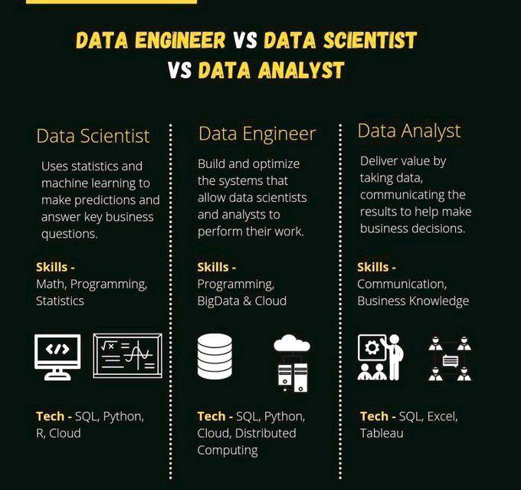

Slide 8
What is the point of anaconda?
Anaconda is a distribution of the Python and R programming languages for scientific computing (data science, machine learning applications, large-scale data processing, predictive analytics, etc.), that aims to simplify package management and deployment.

Slide 9
Why should we use anaconda for python?
Firstly, since Anaconda comes with a bunch of data science packages, you'll be all set to start working with data.
Secondly, using conda to manage your packages and environments will reduce future issues dealing with the various libraries you'll be using.

Slide 10
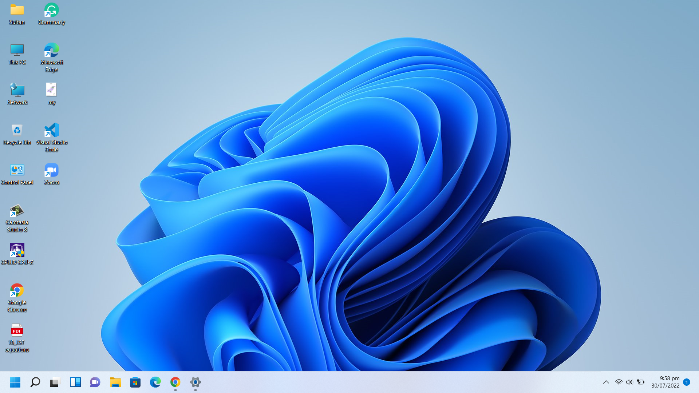

Slide 11
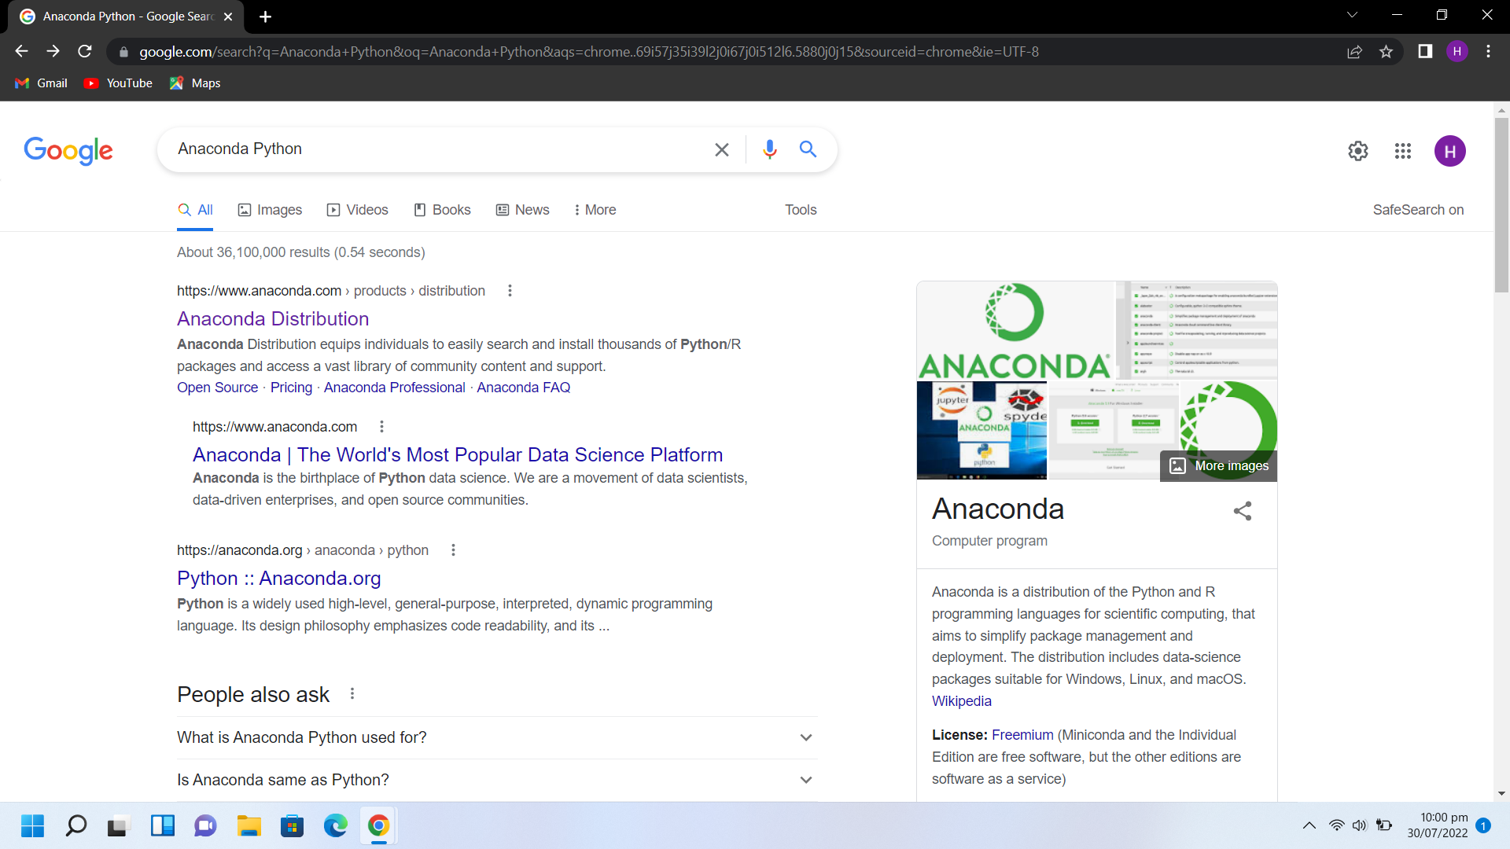

Slide 12
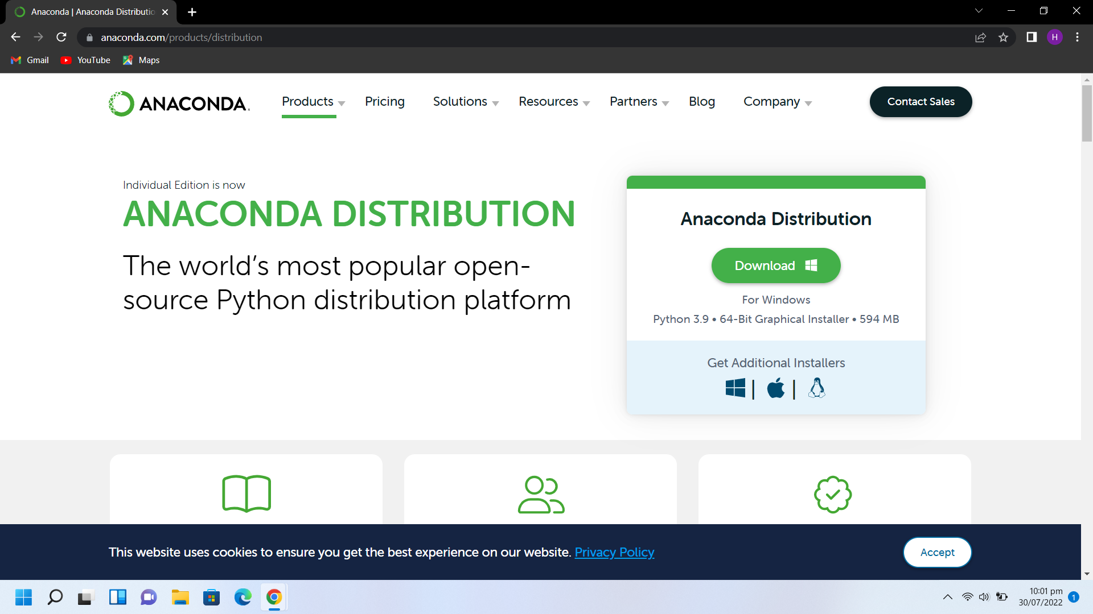

Slide 13
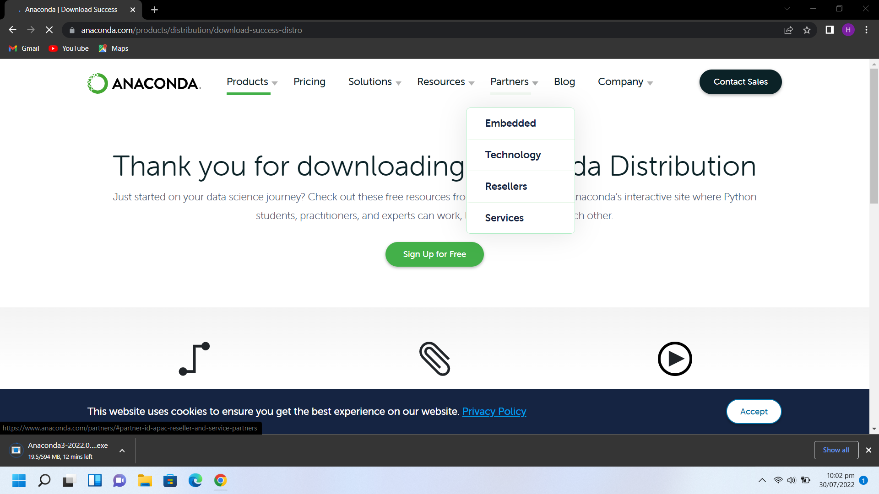

Slide 14
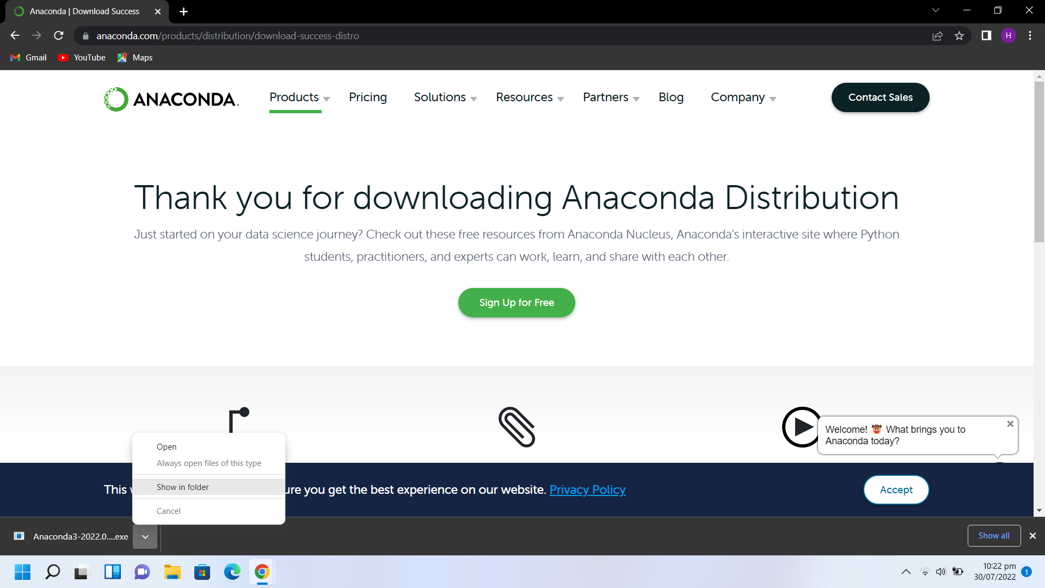

Slide 15
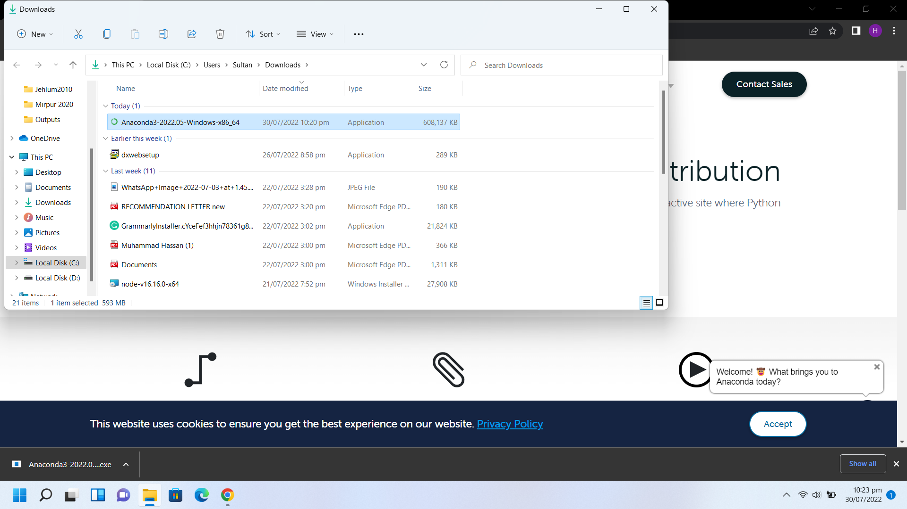

Slide 16
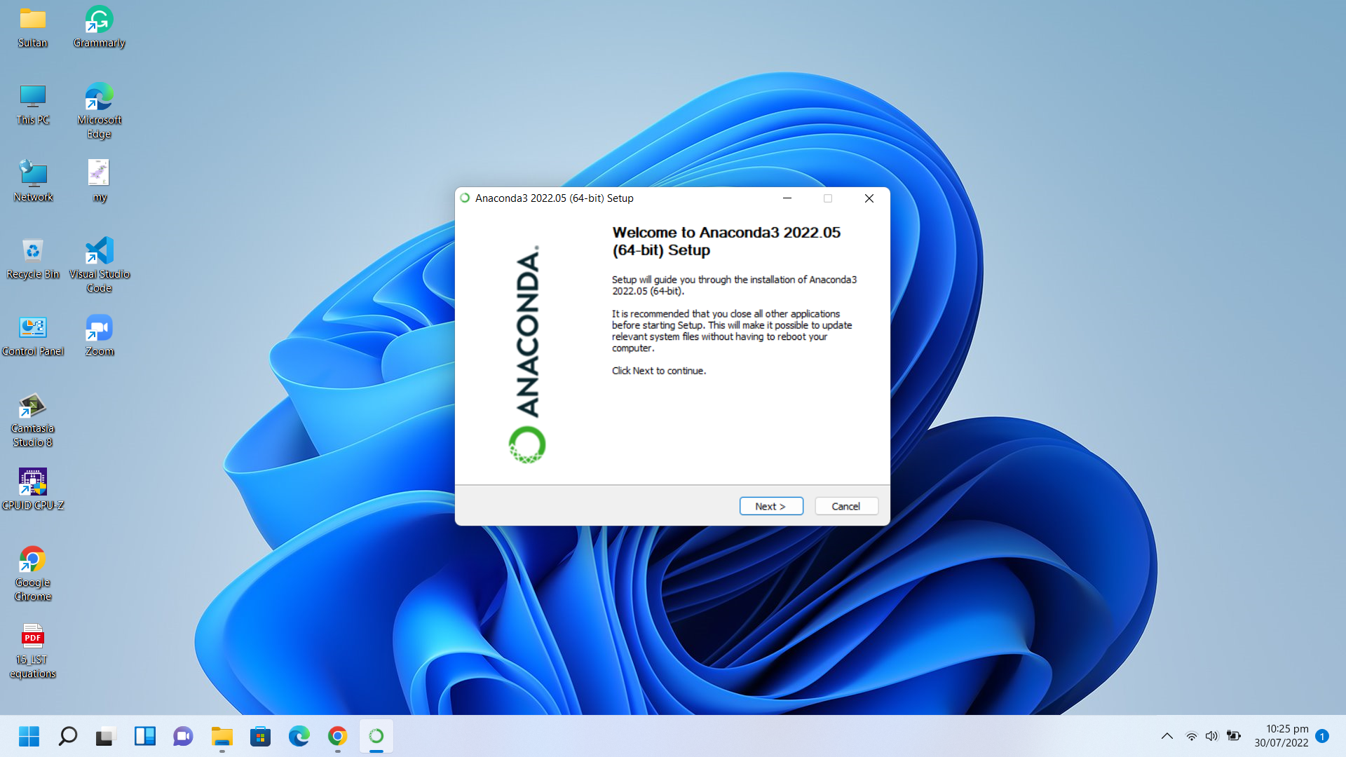

Slide 17
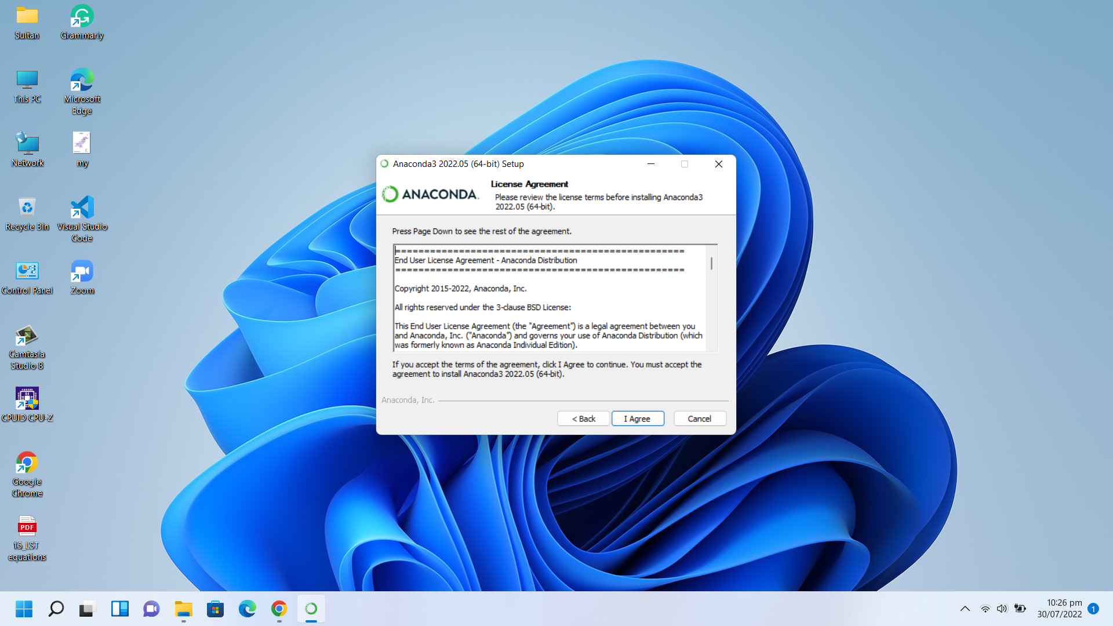

Slide 18
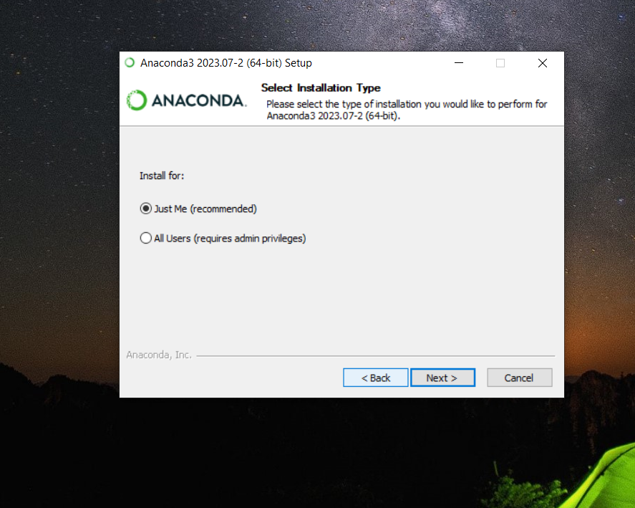

Slide 19
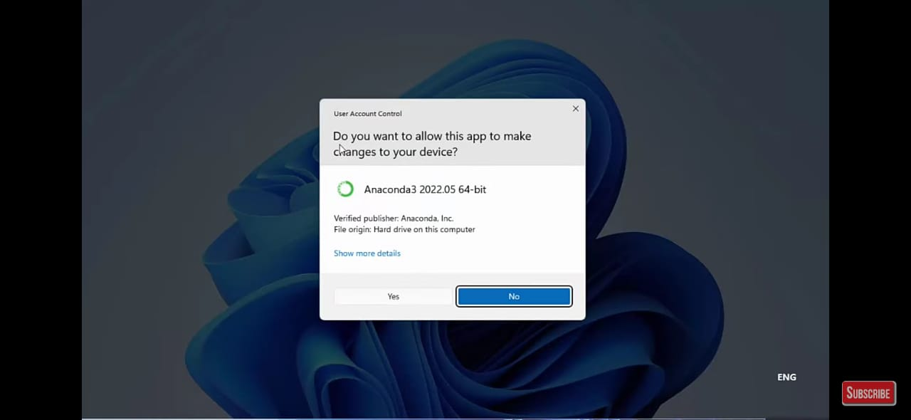

Slide 20
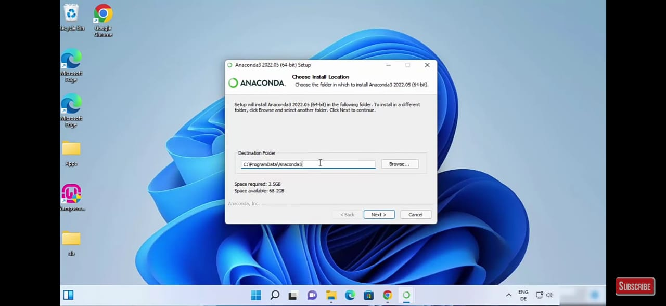

Slide 21
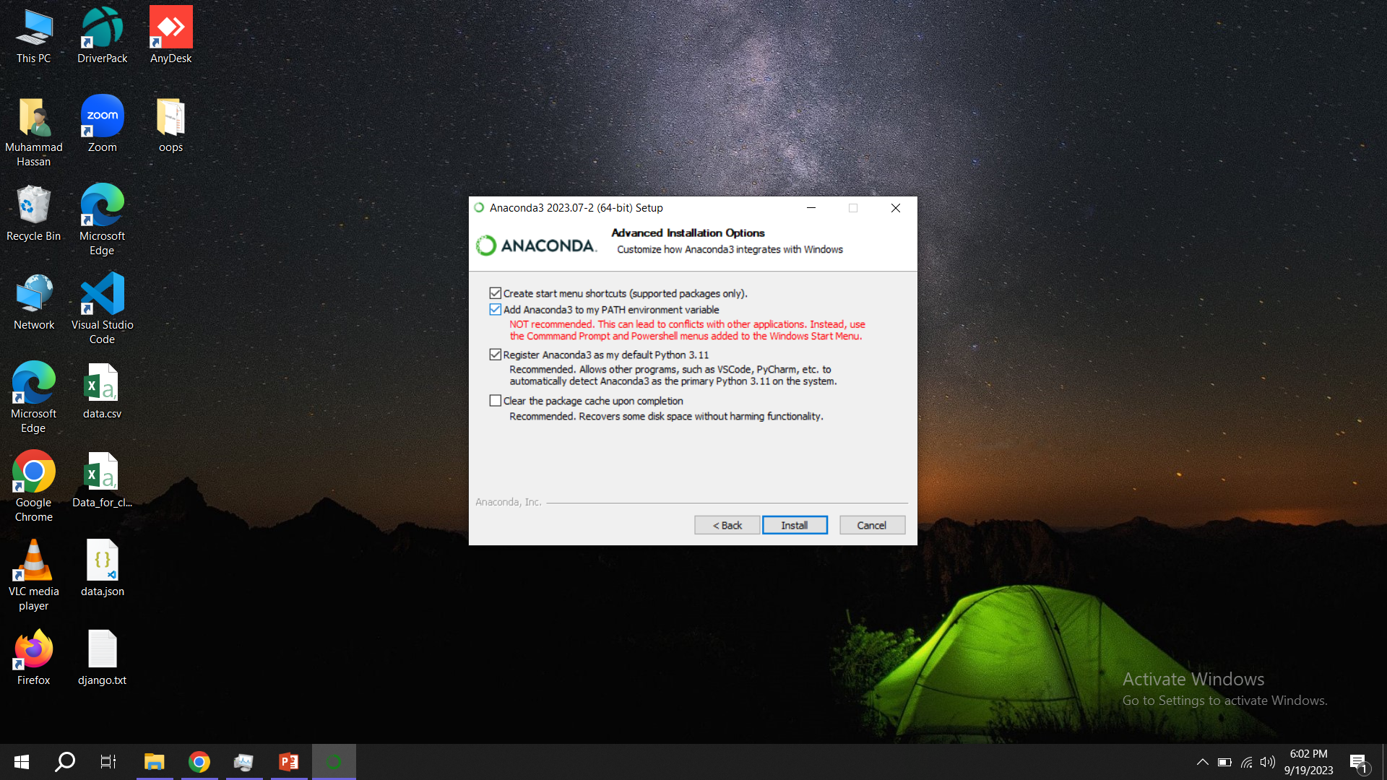

Slide 22
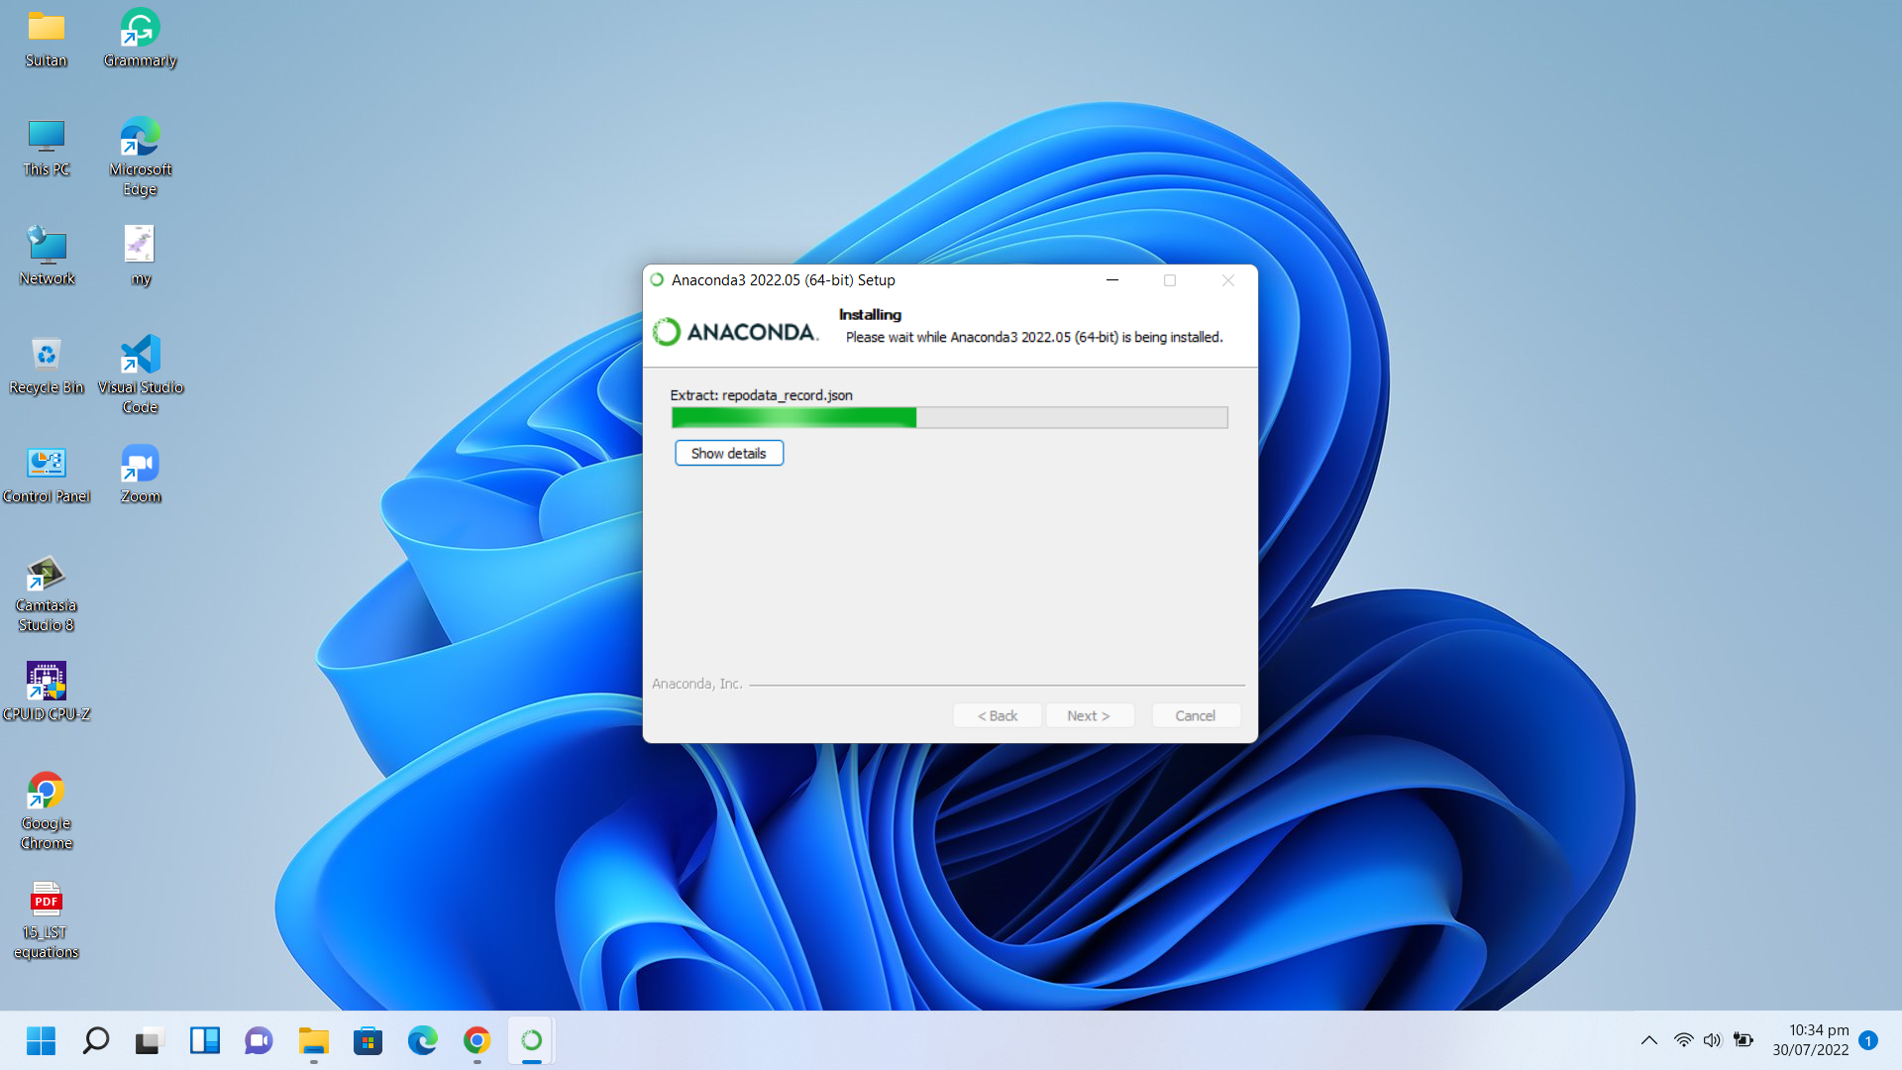
Installing

Slide 23
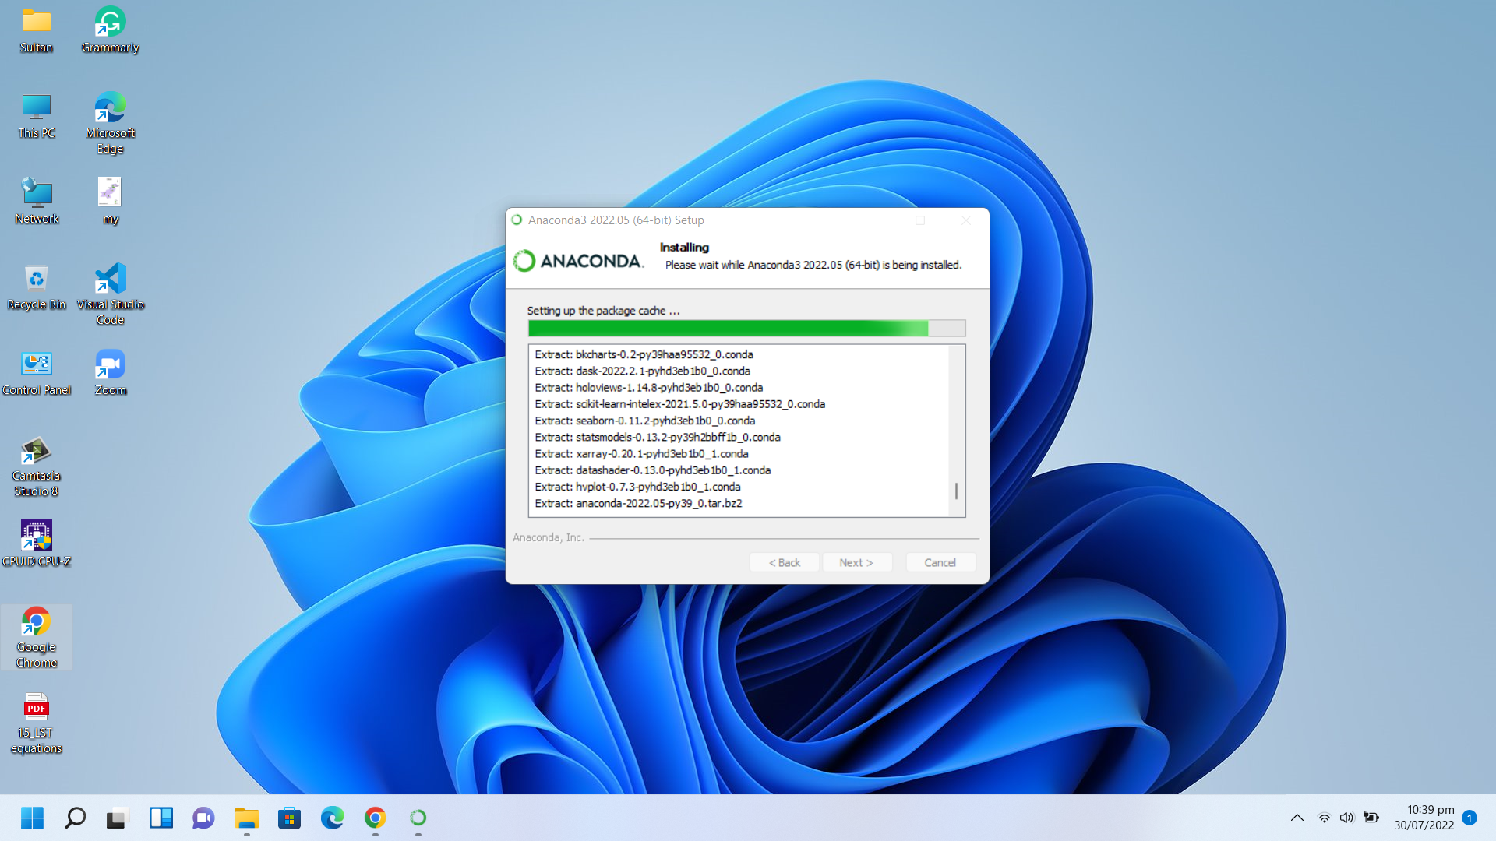

Slide 24
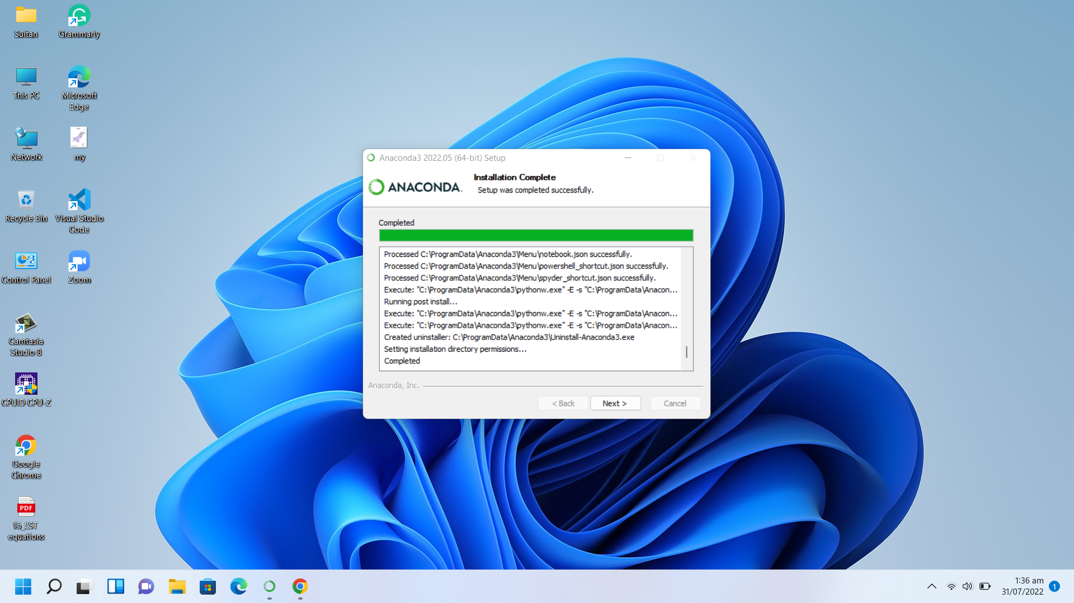

Slide 25
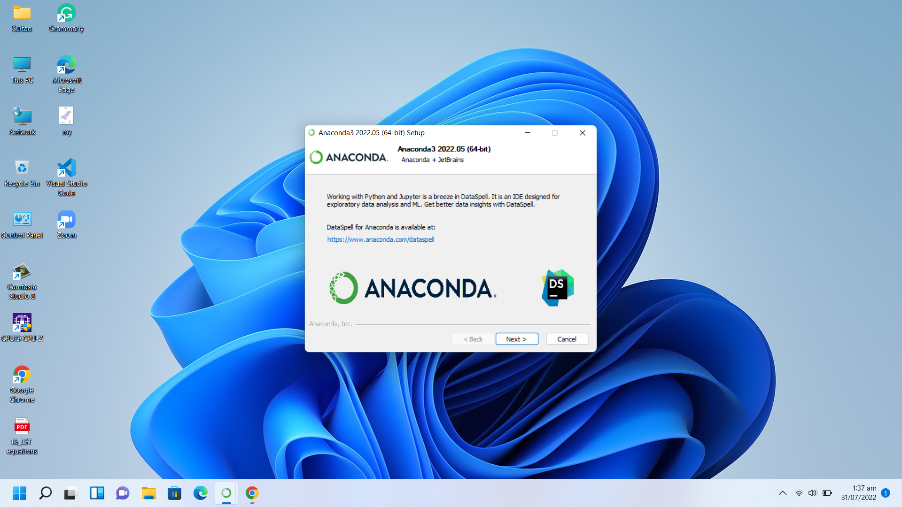

Slide 26
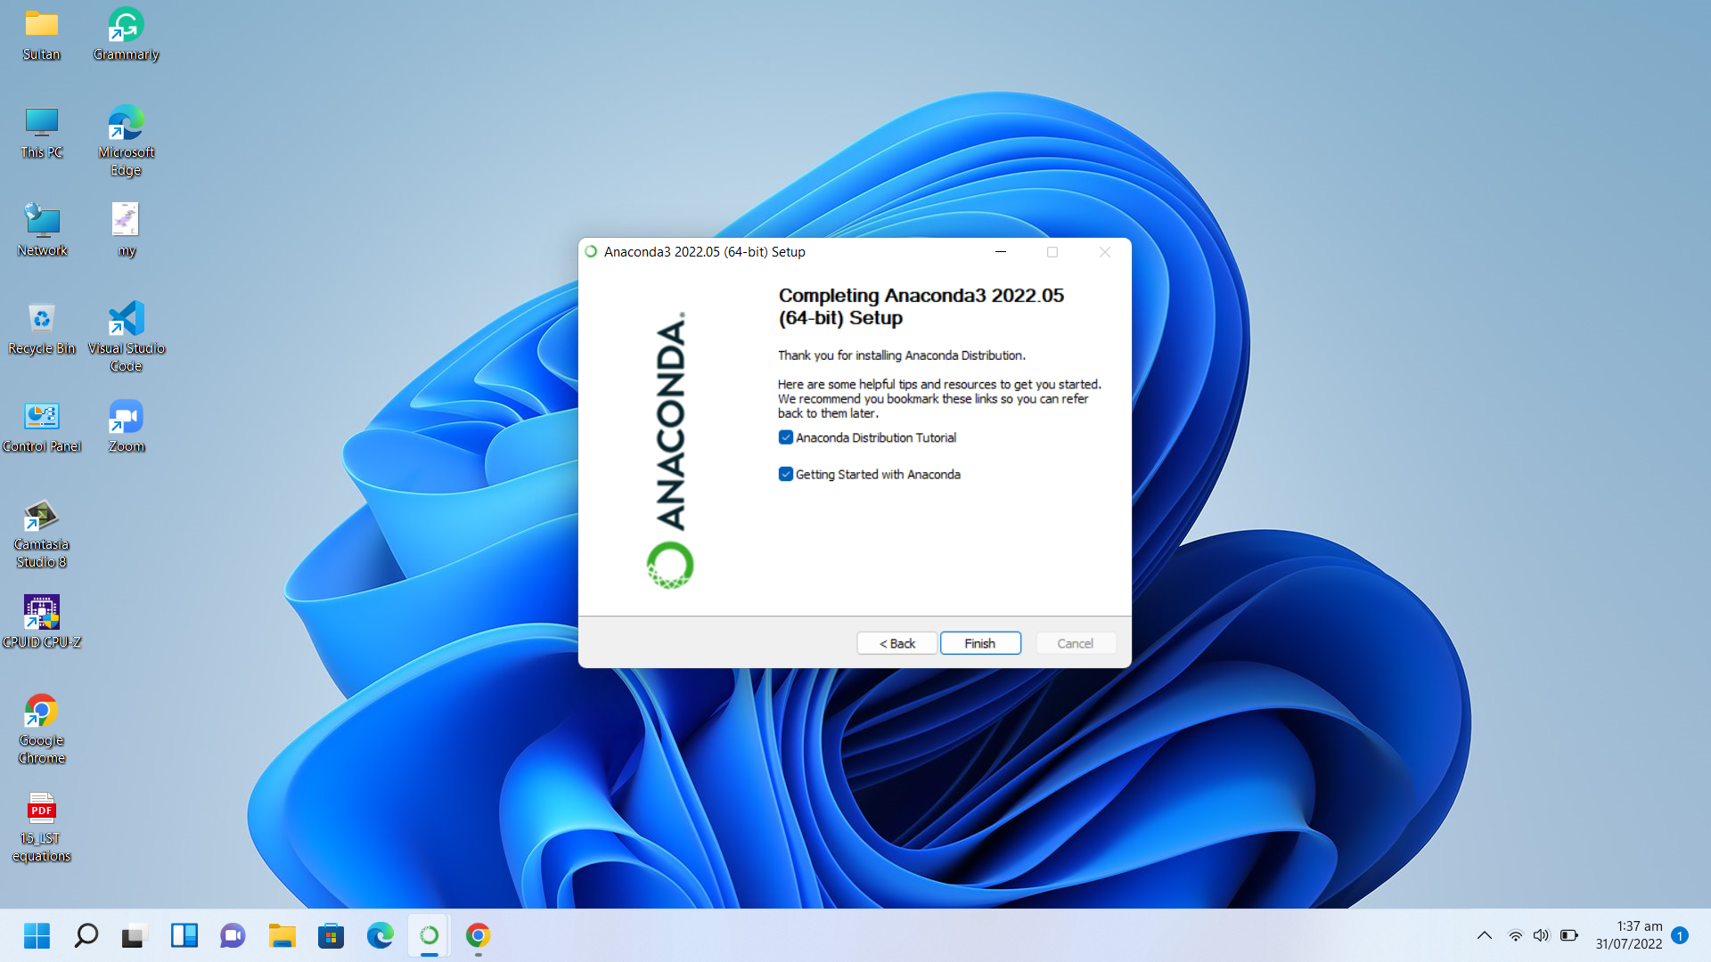

Slide 27


Slide 28
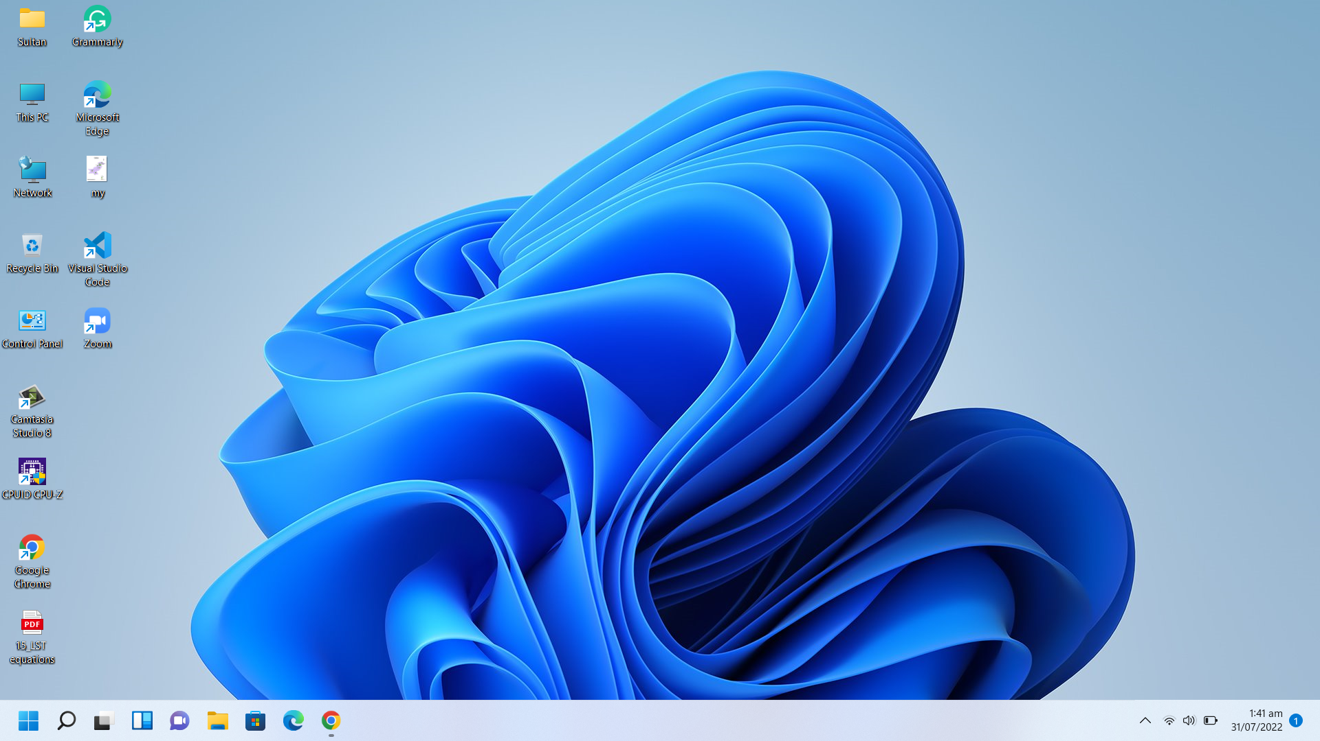

Slide 29
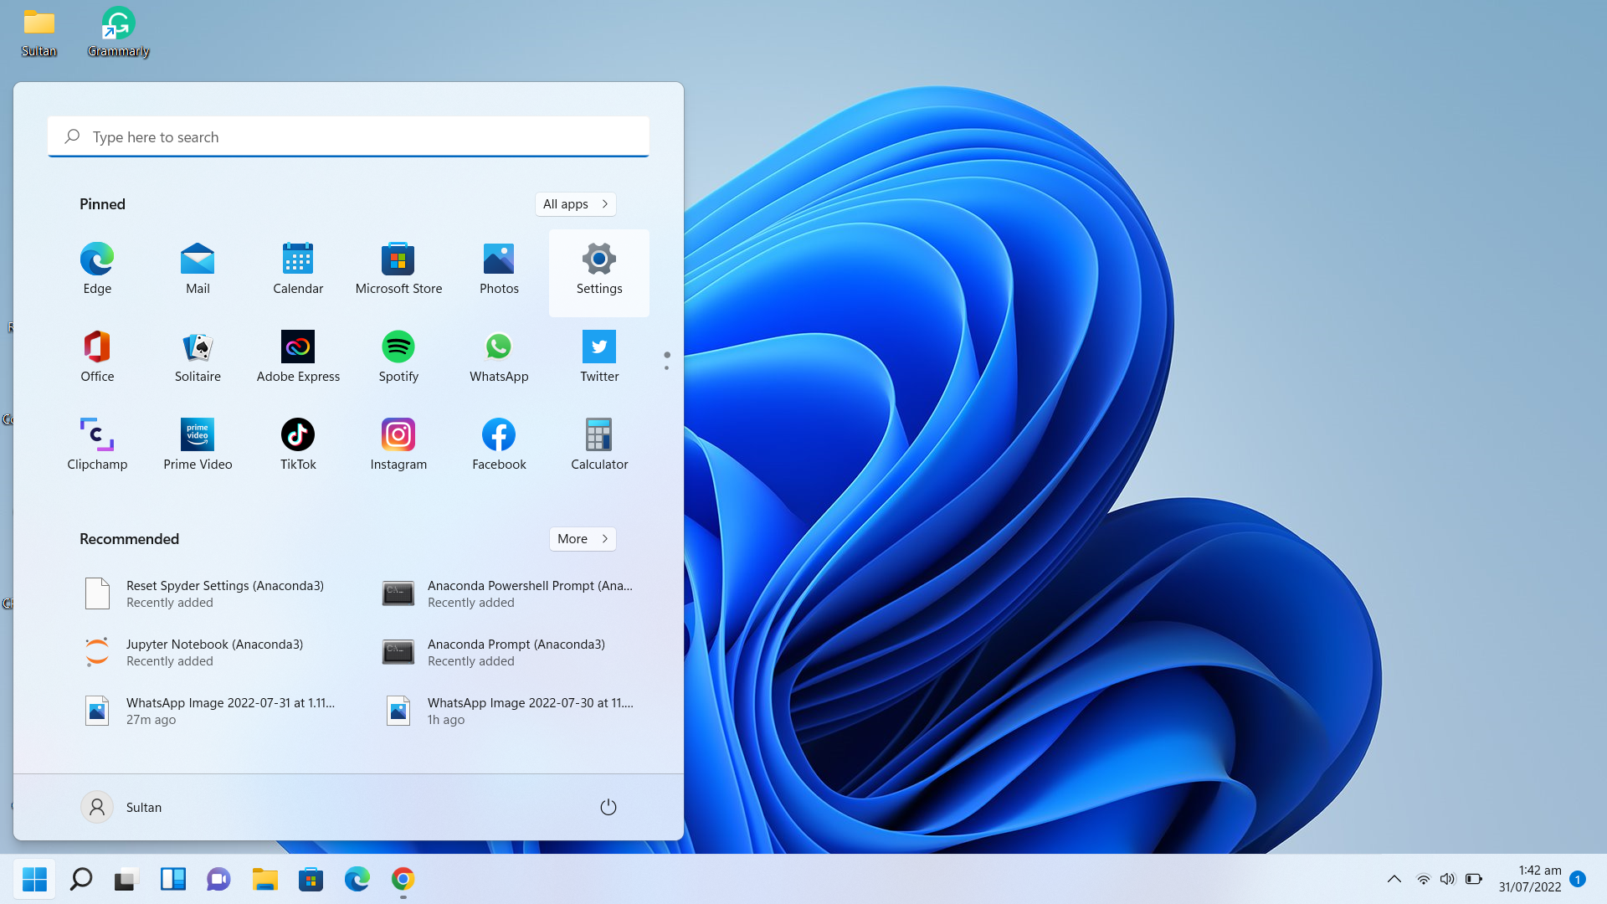
Also search anaconda in search bar

Slide 30
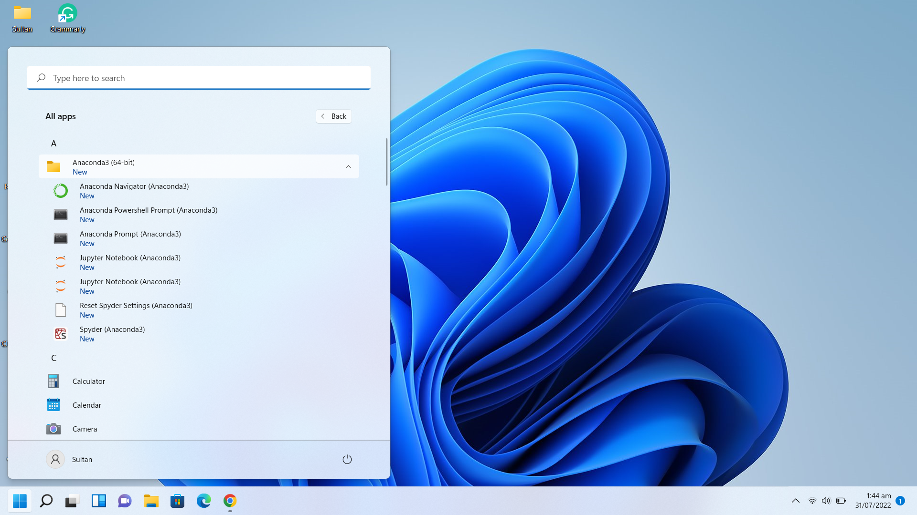
open

Slide 31
Task:-----
Check your python version.
Check your Conda version.
Visit Anaconda Navigator.
Using Anaconda prompt start jupyter notebook.
Create new folder for your python programming practice.
Create new file for your task.
Add 10+20, Subtract 50-25, Multiply 7*3, divide 8/2 and square of 7 in python.
Print hello world and your name in individual line.
How to write python syntax.
Create comment in python.

